Slide 1


Automation Tests

Slide 2
Introduction
About me:
Name: Ayman
Age: 29
Residence: Isfiya

Slide 3
timeanddate.com Automation QA:
The process involves several key documents and steps to ensure thorough testing and validation of the site and its functionality. In this presentation, we will focus on showing automation tests run on the site using python selenium.

Slide 4
pre-requisite documents:
STP
Purpose: The STP outlines the overall testing strategy and approach for the project. It defines the scope, objectives, and methodology of the testing process.
link
STD
The STD provides detailed test cases and scenarios based on the requirements specified in the STP and SRS.
link

Slide 5
Automation tests
Steps

Slide 6
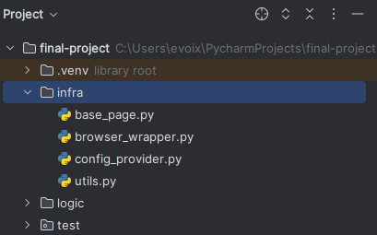
Step one:
Infrastructure:
Used to set up the general testing environment, mainly:
Load up browser
Load config file
3. Include a utilities library, which contains commonly used functions

Slide 7
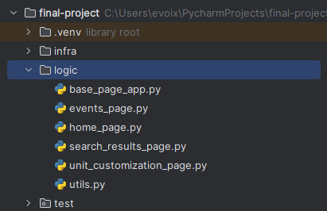
Step two:
Logic:
This involves defining the testing procedures and operations, focusing on:
1. Writing scripts to automate the test cases
2. error handling and reporting mechanisms
3. Structuring the test flow to ensure comprehensive coverage and efficiency

Slide 8
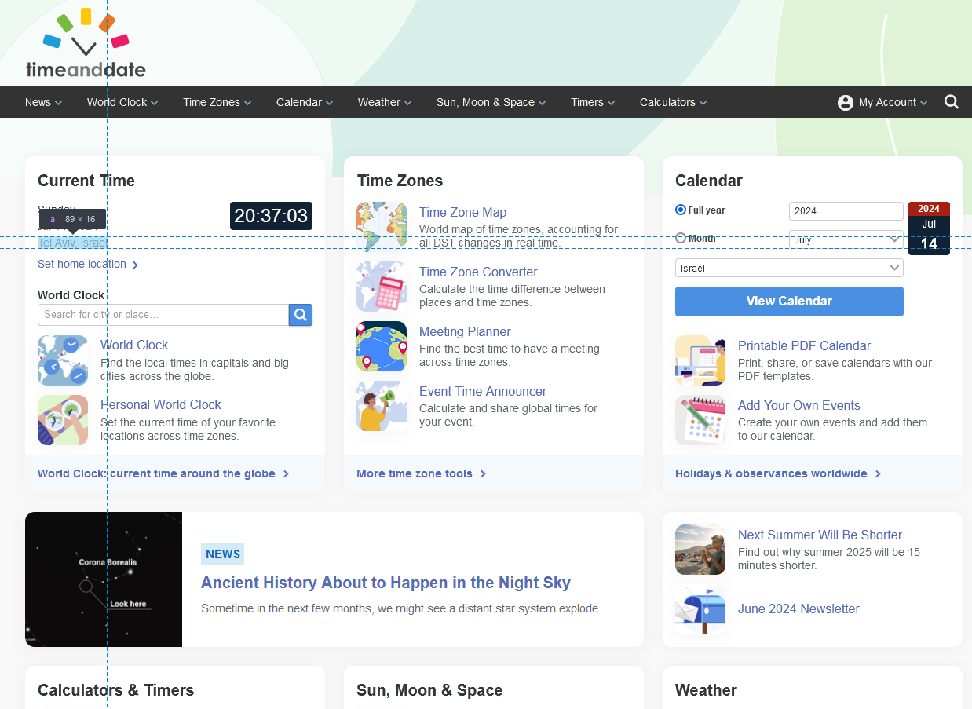
Example for accessing an element

Slide 9
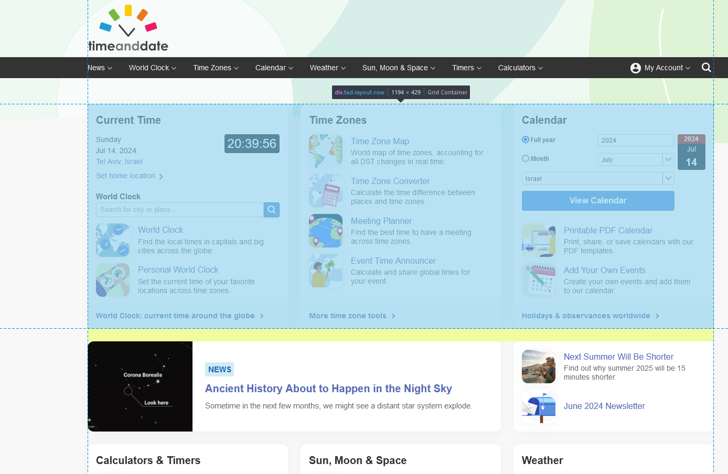
Example for accessing an element
Main section

Slide 10
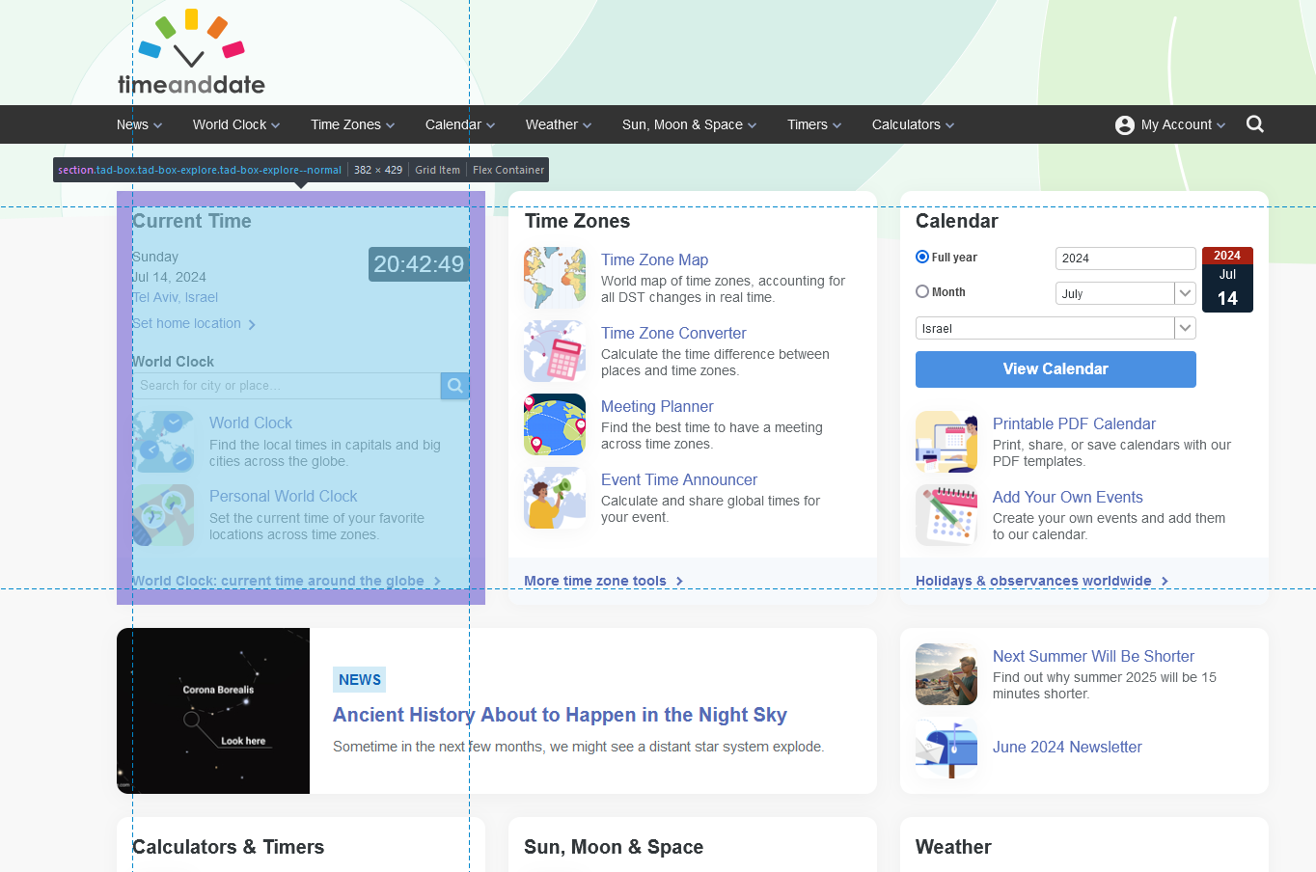

Example for accessing an element
Sub section

Slide 11
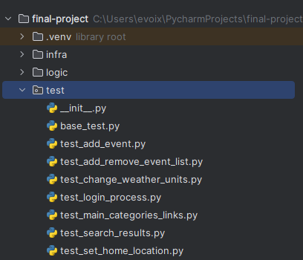
Step three:
Testing:
This phase involves executing the test plans and verifying the outcomes, including:
1. Running automated test scripts
2. Validating the functionality against expected results
3. Logging defects and issues identified during testing

Slide 12
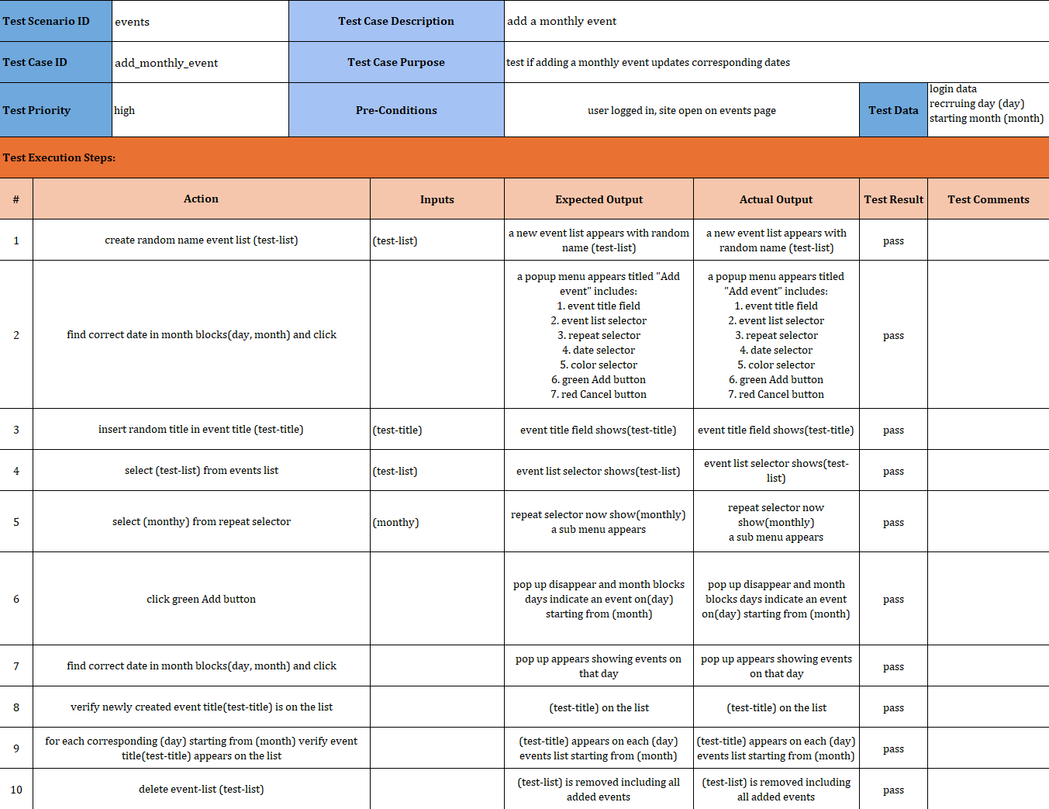
Example test case
Feature to test:
Create an event recurring on the same day each month

Slide 13

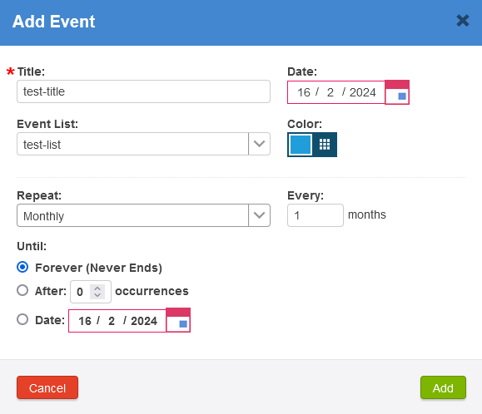
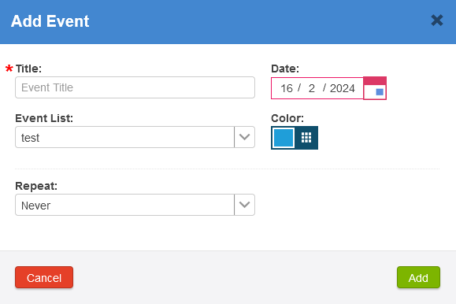

Step 1 (setup):
Steps 3-6:
Create list
3. Fill
4. Pick list
5. Pick recurrence
Step 2:
Click
6. Click

Slide 14
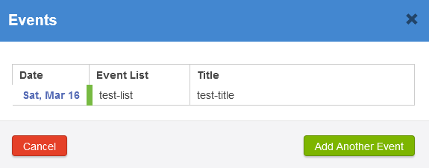
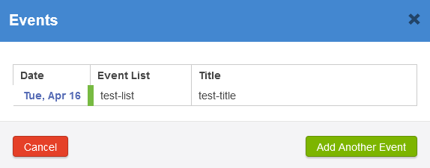
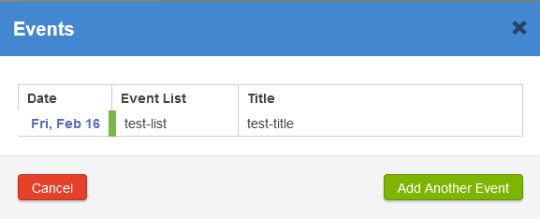
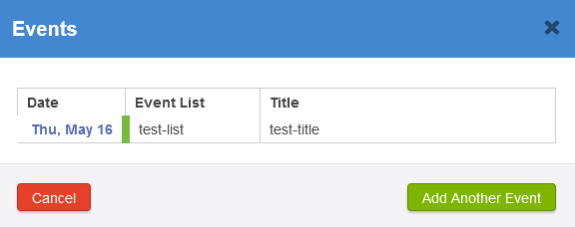

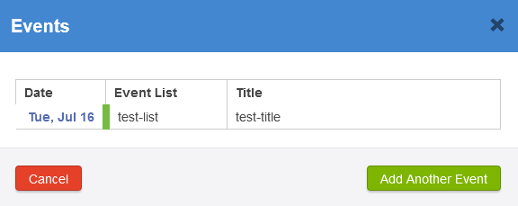

Step 7:
Step 9: confirm event is found on other months
Click
Step 8:
Click

Slide 15
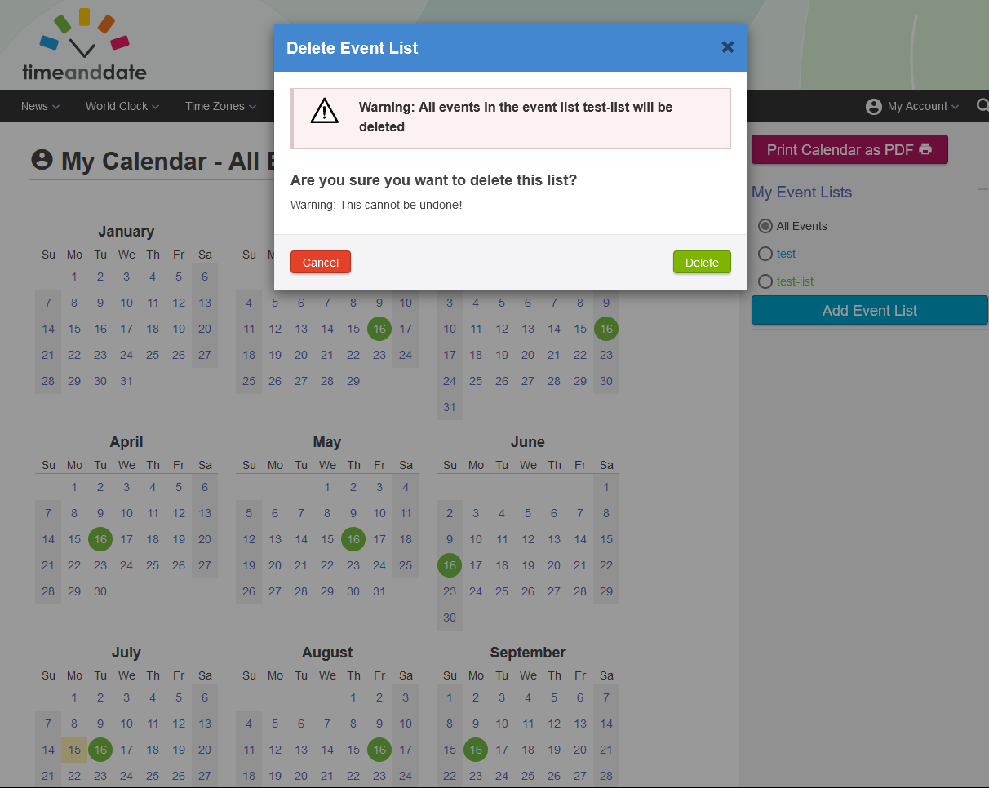

Step 10 (teardown):

Slide 16
Thank you for listening
Conclusion –using automation tests helps:
1.reduces human error
2.allows for continuous integration and delivery.
3. A broad coverage of tests

